Slide 1




Software Development Laboratory
01
Course Code-2200
Project Title: PhoneBook
Submitted By:
Submitted To:
NAME: Rezwan Ahmed
ID: 20241042010
CSE
North Western University
Nusrat Jahan Urme
CSE, Lecturer
North Western University

Slide 2

CONTENTS
01
Introduction
05
Approach
02
02
Objectives
06
Implementation
02
03
07
Output
Problem Description
04
08
01
Conclusion
Tools & Techs

Slide 3

Part 1
Introduction
The Phone Book Management System is a C++ program designed to store and manage contact details such as names, phone numbers, and email addresses. It allows users to easily add, view, search, edit, and delete contacts. Using file handling, the program keeps data saved permanently, making it a simple and effective way to organize personal or professional contacts digitally.

Slide 4



Part 2
Objectives
Add, delete, and search contacts
Edit existing information
Store data permanently & use vector and structure for data organization
Easy user interface
To apply the fundamental concepts of C++ programming.
The features ensure a user-friendly experience for managing personal or professional contacts.
This set of features represents a fully functional phonebook that excels in core functionality, data integrity, and usability.

Slide 5
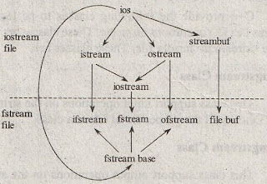
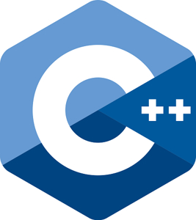
File Handling
File handling ensures that contact information is saved permanently even after closing the program. In C++, file streams like fstream, ifstream, and ofstream are used for reading and writing contact data.

Slide 6




Part 3
Problem Description
Name
Number
E-mail
Managing contacts manually can be time-consuming and prone to errors. Users often need a convenient way to store and retrieve personal or professional contact information. This program provides an efficient, console-based solution where contacts can be easily added, viewed, edited, and deleted. It eliminates the need for manual record keeping and ensures data persistence even after the program is closed.

Slide 7

Part 4
Tools & Techs
Input/Output System
File Handling for permanent storage
Computer with a minimum 2 GB RAM
Operating System: Windows / Linux
Compiler: g++ or Code::Blocks
These are the technical building blocks of a phonebook program implemented in C++.

Slide 8
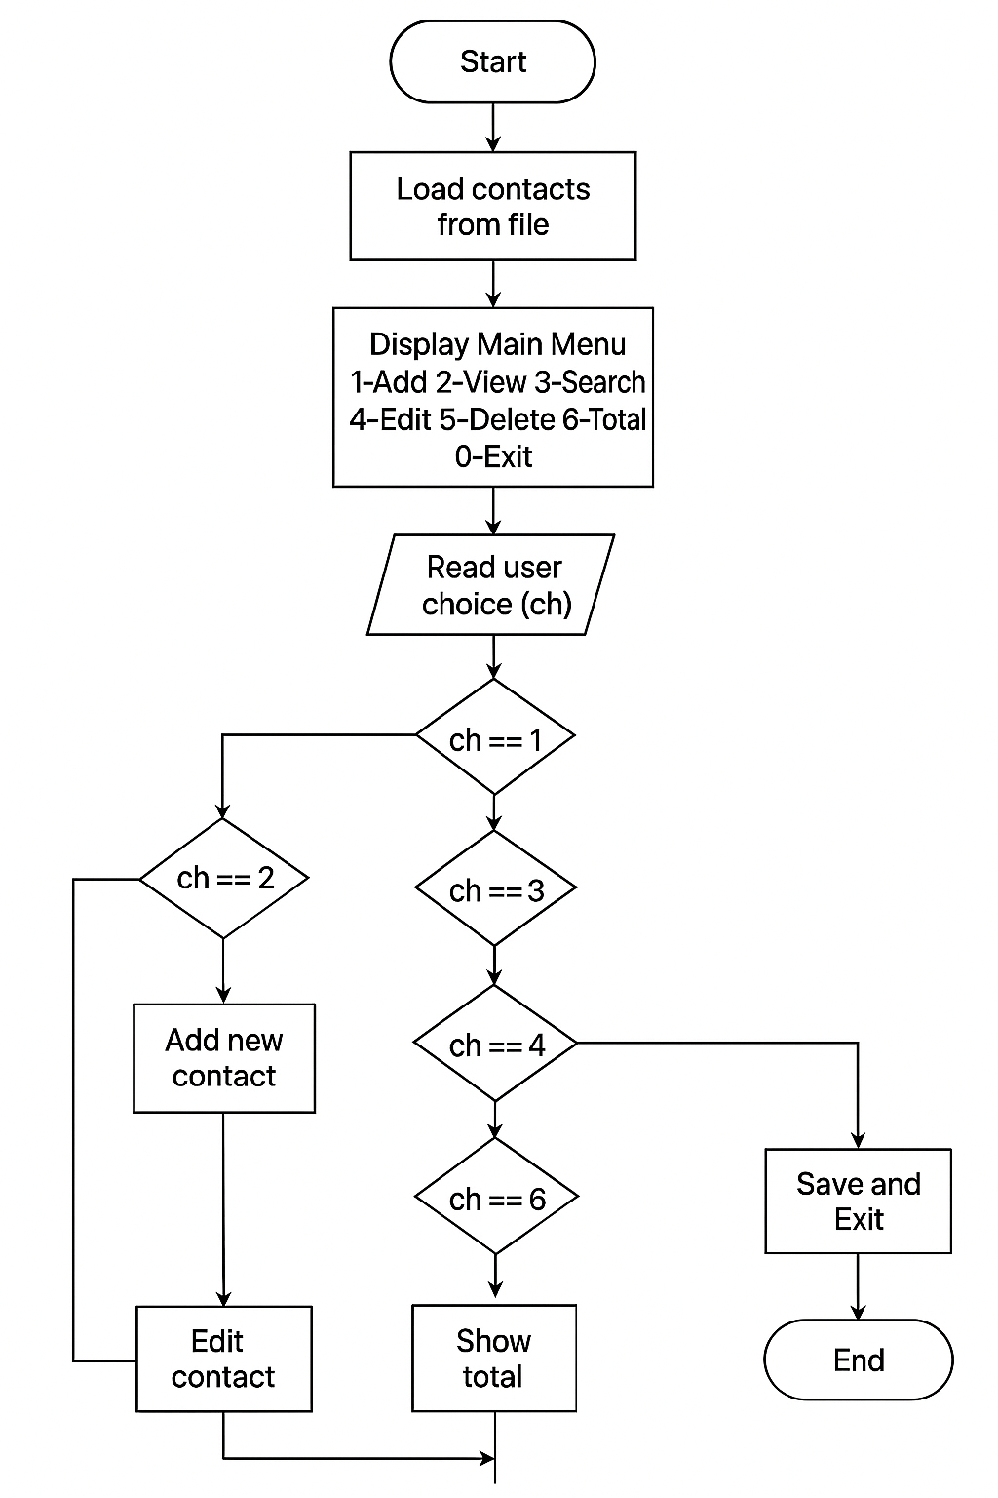
Part 5
Approach
It starts by loading contacts from a file, then repeatedly shows a menu where the user can choose to add, view, search, edit, delete, or count contacts. Based on the user’s choice, the corresponding action is performed. The program ends by saving all contacts and exiting.

Slide 9
Part 6
Implementation
struct Contact {
string name, phone, email;
};
void saveContacts(const vector<Contact> &contacts) {
ofstream file("contacts.txt");
for (auto &c : contacts)
file << c.name << "\n" << c.phone << "\n" << c.email << "\n";
file.close();
}

Slide 10
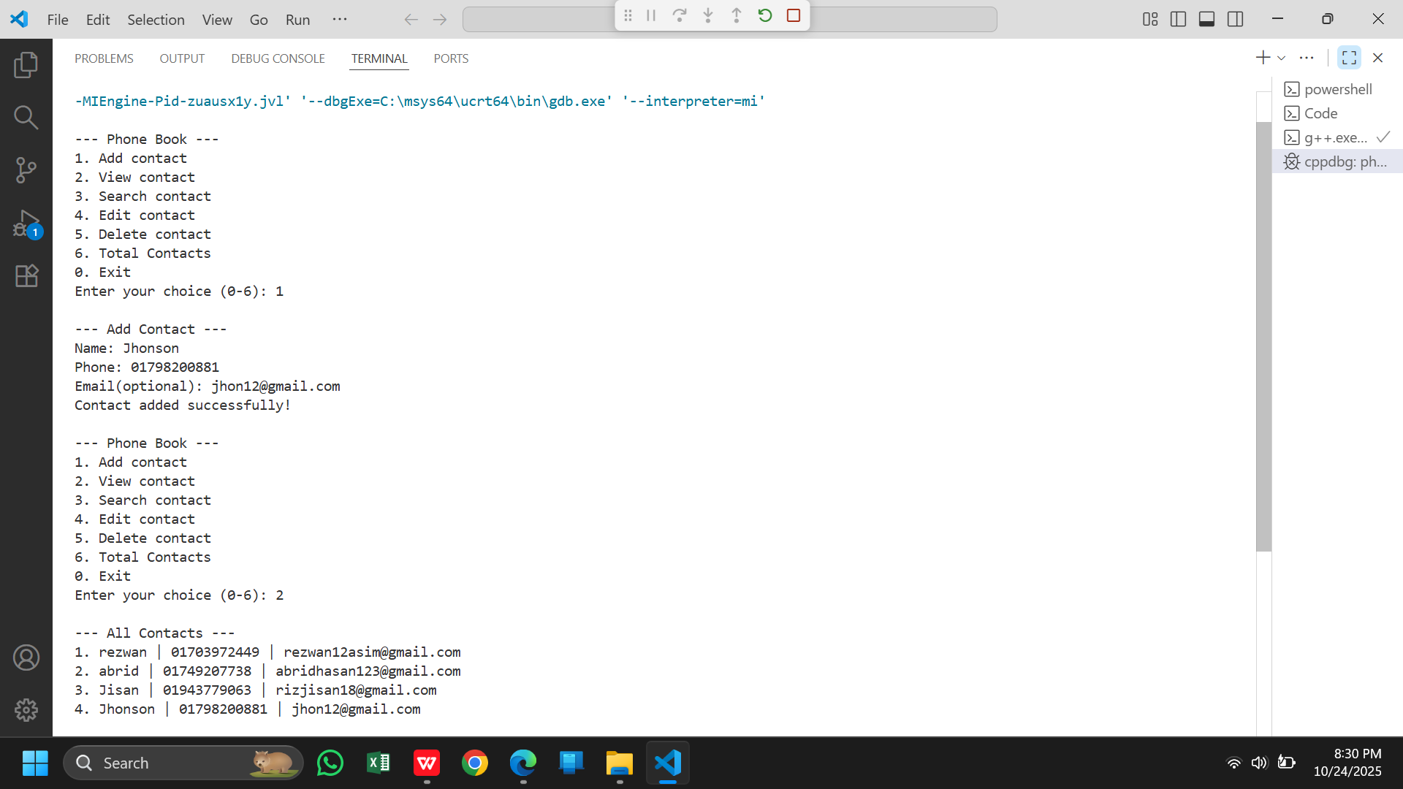
Part 7
Output

Slide 11


Conclusion
Phonebook applications are simple yet powerful tools for managing contacts effectively.
Overall, it provides a practical example of how real-world data can be organized and managed effectively using programming.

Slide 12
Thank you
For watching
Here I will leave a Github Link for this Project.
I appreciate your time and patience. If there is any questions feel free to ask.

